Slide 1





Raspberry Pi-based Face Recognition Door Lock System
Name: Seifeldin Sherif Elnozahy
Student ID: 1191102388
Supervisor: DR. Chinnaiyan Senthilpari
Modrator: DR. Lee Chu Liang
Date: 05-FEB-2025
Multimedia University

Slide 2

Table Of
Contents
Introduction
Problem Statement
WHY THIS PROJECT?
Literature Review
System Overview
Hardware Implementation
Software Implementation
Flowchart of System Operation
Experimental Setup & Testing
Model Training and Adaptation
Real-Time Notifications & Security Alerts
Adding Unknown Faces
Emotion detection
Real-Time Face Recognition & Authentication
Comparison with Existing Systems
Discussion of Results
Limittions & Future Improvements
Conclusion
Demonstration Video
Q&A

Slide 3

Introduction
Security plays a vital role in protecting both residential and commercial properties.
Traditional locks present several vulnerabilities: keys can be lost, duplicated, or stolen, and PIN codes can be guessed or hacked.
Facial recognition technology is a modern solution that eliminates these security risks by utilizing biometric authentication.
This project aims to develop an affordable and scalable Raspberry Pi-based face recognition door lock system that enhances security, provides real-time notifications, and adapts to environmental conditions.

Slide 4


Problem
Statement
Traditional key-based locking mechanisms have significant security flaws:
Lost or stolen keys allow unauthorized access.
Locks can be picked, and keys can be duplicated.
PIN-based access codes are susceptible to brute force attacks or hacking.
Existing biometric authentication systems tend to be expensive and require specialized hardware, making them inaccessible for small-scale users.
There is a need for a low-cost, efficient, and adaptive security solution that eliminates these vulnerabilities and ensures reliable access control.

Slide 5
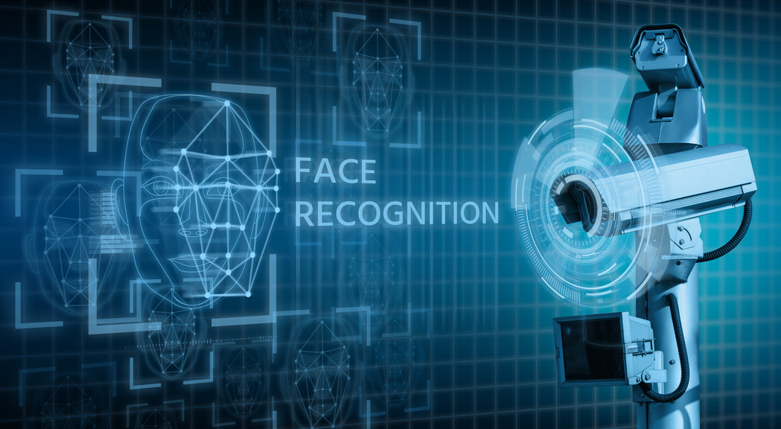
WHY
THIS PROJECT?
Objectives:
Develop a real-time facial recognition door lock system that utilizes Raspberry Pi and OpenCV for authentication.
Enhance security and efficiency by eliminating the need for physical keys or PINs.
Ensure high recognition accuracy in varying lighting and environmental conditions.
Integrate adaptive learning capabilities, allowing the system to update its database dynamically.
Enable real-time notifications for user authentication logs, including alerts for unauthorized access attempts.
Motivations:
Enhance security by reducing vulnerabilities associated with traditional locks.
Improve efficiency in access control systems.
Increase user-friendliness by eliminating the need for physical keys.
Leverage advancements in AI and machine learning for better security solutions.

Slide 6
Literature
Review
Overview of Previous Research on Facial Recognition:
Facial recognition technology has evolved from basic feature-based methods to deep learning models.
Traditional methods like Eigenfaces and Fisherfaces were used in early systems but struggled with lighting and pose variations.
Modern approaches use machine learning and deep learning, improving accuracy and adaptability.
Researchers have explored various face detection techniques:
Haar Cascade classifiers: Lightweight and real-time but with high false-positive rates.
Histogram of Oriented Gradients (HOG) + SVM: More robust but sensitive to lighting changes.
Convolutional Neural Networks (CNNs): High accuracy but requires significant processing power.
Existing Research Challenges:
High dependency on lighting conditions.
Performance limitations due to low processing power on embedded devices.
Adaptive learning methods are not commonly integrated into face recognition systems.
Our Approach:
Implementing real-time adaptive learning.
Improving recognition under varying environmental conditions.

Slide 7
SUMMARY
Paper | Techniques/Algorithms Used | Key Findings | Challenges/Limitations
A Face Recognition Method In Machine Learning (ML) For Enhancing Security In Smart Home | CNN, CNN Mobilenet, CNN Alexnet | High accuracy in recognizing faces | Data preparation, computational complexity, privacy concerns
Raspberry Pi-Powered Door Lock with Facial Recognition | OpenCV, Haar Cascade | Effective for secure access control | Processing power and time for training, importance of reliable internet connectivity
Face Recognition Door Lock System Using Raspberry PI | Haar Cascade Classifier, OpenCV | Accurate face detection, cost-effective solution | Real-time processing limitations
Home Security System Based On Facial Recognition | HOG algorithm, IoT, GSM | High precision and efficiency, remote access control | Privacy concerns, user acceptance
Face Recognition Door Lock System Using Raspberry Pi | PCA, OpenCV | Cost-effective, low power consumption | Integration with existing security infrastructure

Slide 8

System
Overview
Hardware Components
Software Components
Raspberry Pi 3B: Serves as the central processing unit, executing facial recognition algorithms and controlling the lock mechanism.
Camera Module V2: Captures real-time images for facial detection and recognition.
Relay Module: Acts as an electronic switch to control the solenoid lock upon successful authentication.
Solenoid Lock: Physically secures or releases the door based on recognition results.
Power Supply: Ensures stable operation of the Raspberry Pi and peripherals.
OpenCV: Handles image processing, face detection and pre-processing tasks to enhance recognition accuracy.
DeepFace: Implements deep learning-based facial recognition and emotion detection to classify known and unknown individuals.
Python-based Control System: Manages face detection, recognition, access logging, and adaptive learning.
Real-time Notifications: Sends alerts or access logs upon recognition events.

Slide 9
Hardware
Implementation
Circuit Connections and Assembly Process
Prepare the Raspberry Pi:
Insert the preloaded microSD card with the OS and software.
Connect the Camera Module to the CSI port, ensuring correct ribbon alignment.
Secure the Raspberry Pi on a stable platform or protective case.
Connect the Relay Module:
Wire the relay module to the Raspberry Pi:
VCC → 5V GPIO
GND → GND GPIO
IN1 → GPIO 17
Position the relay close to the Raspberry Pi for secure wiring.
Wire the Solenoid Lock:
Positive terminal of 12V Solenoid Lock → NO (Normally Open) terminal of relay.
COM (Common) terminal on relay → Positive terminal of 12V DC Power Supply.
Negative terminal of solenoid lock → Negative terminal of 12V DC Power Supply.
Integrate the DC Barrel Jack:
Use a DC barrel jack adapter to securely connect the 12V DC power supply to the solenoid lock and relay module.

Slide 10
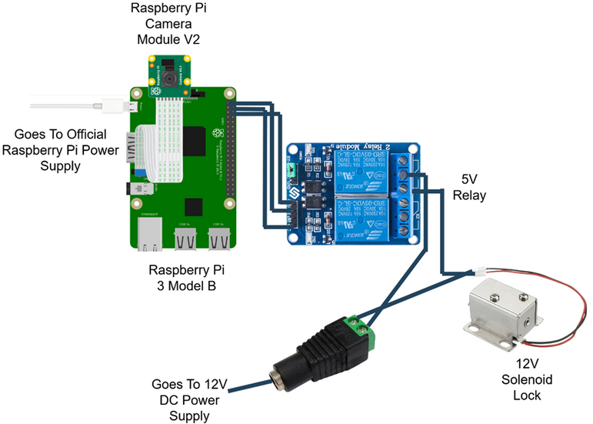
Hardware
Implementation
Circuit Connections and Assembly Process
5. Establish Stable Connections:
Verify all jumper wires are secure and correctly aligned.
Inspect relay, solenoid lock, and Raspberry Pi GPIO pins for loose wires or misconfigurations.
6. Power Up the Raspberry Pi:
Use the official power adapter to power the Raspberry Pi via micro-USB.
Confirm the 12V DC power supply is securely connected to the relay and solenoid lock.
Circuit diagram illustrating the hardware connections

Slide 11
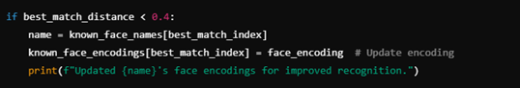
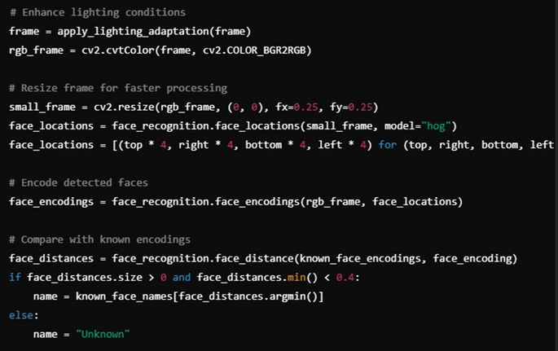
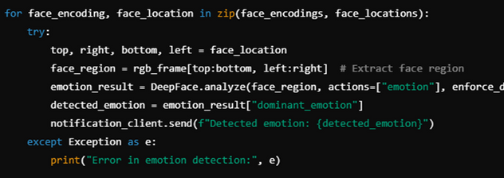
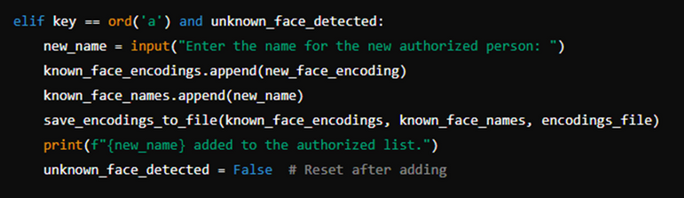
Software
Implementation
Face Detection, Recognition, and Emotion Analysis using OpenCV and DeepFace
Adaptive Learning for Known and Unknown Faces
OpenCV handles real-time face detection, processing video frames for facial recognition.
DeepFace performs facial recognition and emotion detection, classifying emotions such as happy, sad, neutral, surprised, and angry.
The system detects a face, extracts features, and compares them to a stored dataset for authentication.
If a recognized face is detected, access is granted; otherwise, an alert is triggered.
Adaptive learning applies to both known and unknown faces:
If an authorized user’s appearance changes over time, the system updates their stored data to improve recognition accuracy.
If an unknown face is detected, the system allows an authorized user to approve and add the face dynamically.
This feature enhances scalability and system intelligence over time.
Updating Encodings for Known Faces
Face Detection and Recognition in Real Time
Code snippet for emotion detection
Code snippet of adding unknown faces

Slide 12
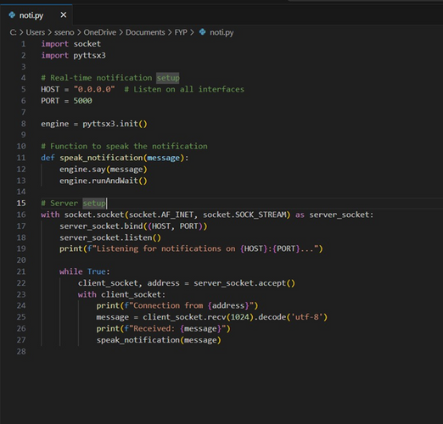
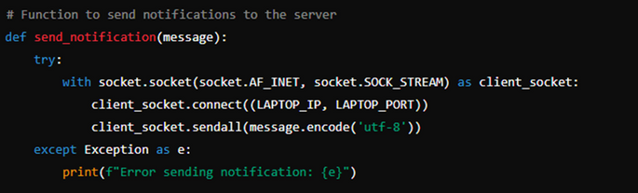
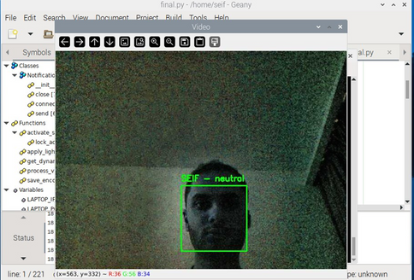

Software
Implementation
Lighting and Distance Adaptation for Improved Accuracy
Real-Time Notifications and Security Alert Integration
The system is optimized to work under varying lighting conditions using:
Histogram Equalization to improve contrast in low-light environments.
Gamma Correction to balance brightness levels.
Distance adaptation ensures accurate recognition at various ranges:
Uses scaling techniques to recognize faces whether they are close or far from the camera.
The model compensates for perspective distortions for better accuracy.
Access logs are updated in real-time, keeping a record of all entry attempts.
Unauthorized access attempts trigger instant security alerts.
Notifications are sent via email or messaging services, providing administrators with immediate updates.
Server-Side Script
The send_notification function
Effect of Lighting Normalization on Face Detection
Example of Triggering Notifications

Slide 13
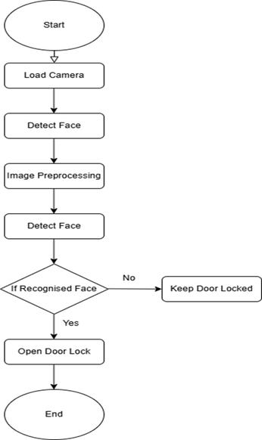
Flowchart of
System Operation
1. Start the System
3. Image Preprocessing
4. Face Recognition & Decision Making
The system initializes and loads the camera module.
The detected face undergoes grayscale conversion, histogram equalization, and normalization to improve recognition accuracy.
The DeepFace model extracts facial embeddings and compares them with the stored dataset.
If a recognized face is detected → Proceed to access control.
If the face is not recognized → The door remains locked.
2. Load Camera & Detect Face
Flowchart of the system
The Raspberry Pi activates the camera and starts capturing frames.
The OpenCV face detection algorithm scans the live video feed to locate a face.
5. Access Control Decision
If a known face is identified:
The Raspberry Pi sends a signal to the relay module, triggering the solenoid lock to unlock the door.
If the face is unknown:
The system denies access and keeps the door locked.

Slide 14
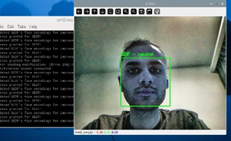
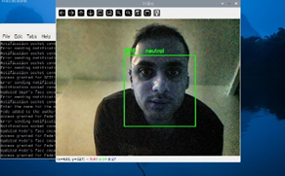
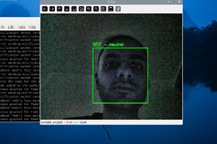
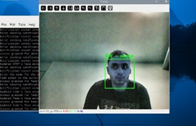
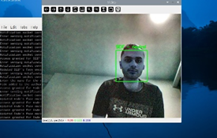
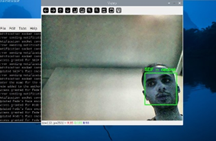
Experimental Setup Overview
The system was tested in real-world environments to assess its accuracy and adaptability under different conditions:
Distance-Based, Facial Orientation & Angle Variations:
Lighting Variations:
Bright Environment: Capturing facial features clearly in high-exposure conditions.
Low-Light Conditions: Evaluating system robustness in poorly lit environments.
Dim-Light Scenarios: Testing adaptability under minimal artificial lighting.
Close-range recognition: Ensuring detailed feature extraction.
Medium-range testing: Assessing detection efficiency at an intermediate distance.
Frontal recognition: Ideal conditions for face identification.
Side angles and narrow perspectives: Evaluating system performance with partially visible faces.
Face Recognitions in a different lighting Environments
Face Recognitions at different Distances and angles

Slide 15
Model Training & Adaptation
Training Methodology for Facial Recognition Accuracy
Adaptive Learning Mechanism for Known & Unknown Faces
The system was trained using DeepFace with a dataset of multiple face images under varying conditions.
Preprocessing steps included:
Grayscale conversion for reducing computation complexity.
Histogram equalization to enhance contrast in low-light images.
Data augmentation techniques to improve generalization.
The model was trained on a Raspberry Pi with optimized settings to balance accuracy and computational efficiency.
Evaluation metrics such as precision, recall, and F1-score were used to measure model performance.
Incremental learning approach:
When a known user’s facial features change (e.g., due to lighting variations, aging, or angle differences), the system updates the stored facial embeddings.
Unknown faces are flagged and can be authorized in real-time by an administrator.
The adaptive learning mechanism improves system reliability by dynamically adjusting the model over time.

Slide 16
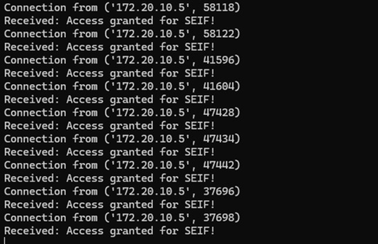

Real-Time Notifications & Security Alerts
Overview of Notification System
Triggering Notifications:
Events such as recognized faces, unknown face detections, and emotion detection activate the notification system.
Messages include details like recognized user names or detected emotions.
Client-Side Communication (Raspberry Pi):
The Raspberry Pi establishes a TCP socket connection with the server (laptop) and sends messages.
Server-Side Processing (Laptop):
The server logs messages in the terminal and provides audible alerts using TTS (Text-to-Speech).
User Feedback:
Users receive real-time access updates and security alerts, prompting action when necessary.
The notification system provides real-time feedback to users about access events.
It supports textual and audible alerts, ensuring users stay informed about:
Recognized faces
Unknown face detection
Emotion detection results
Implemented using a socket-based client-server model, operating efficiently without requiring additional hardware or mobile applications.
Notification for Authorized User
Notification for Detected Emotion

Slide 17
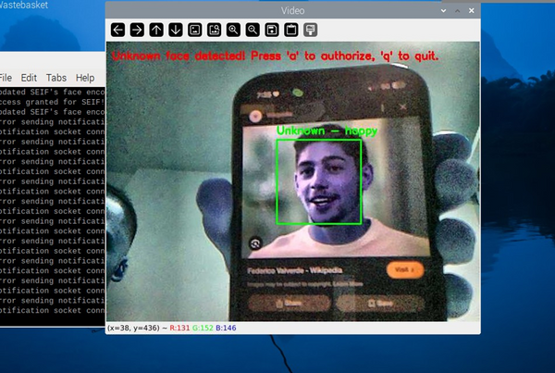

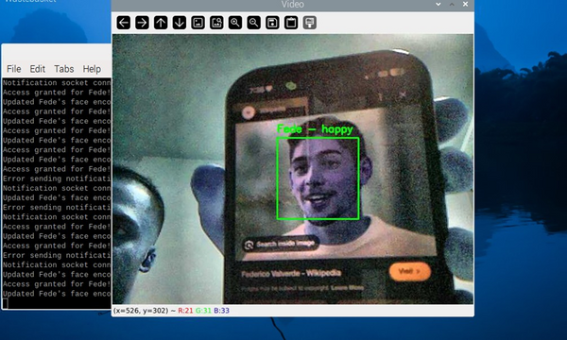
Adding Unknown Faces
Prompting for Unknown Faces
When an unrecognized face is detected, a real-time prompt appears on the Raspberry Pi terminal, requesting the user’s input:
Press ‘a’: Authorize and add the detected face to the dataset.
Press ‘q’: Ignore and quit the operation.
If the user authorizes the face, the 128-dimensional facial encoding is stored along with the provided name.
Storing New Face Encodings
Once a face is added, the dataset dynamically updates with the new face encoding.
The new user is recognized in subsequent interactions without requiring a system restart or retraining.
This ensures efficiency and maintains system robustness.
Recognizing Newly Added Faces
After addition, the system immediately incorporates the updated encoding into the recognition pipeline.
Future detections display the user’s name and emotional state in real-time.
The adaptive learning feature enables the system to evolve dynamically without manual intervention.
Detection of an Unknown Face
Authorizing a New Face in Real Time
Successful Recognition of a Newly Authorized User

Slide 18
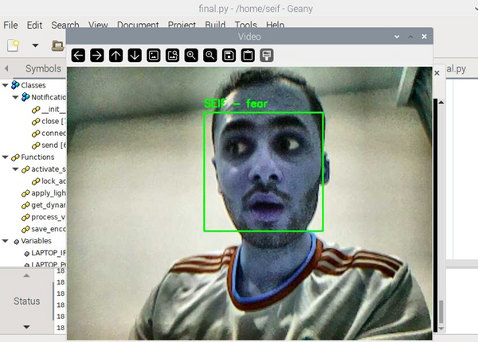
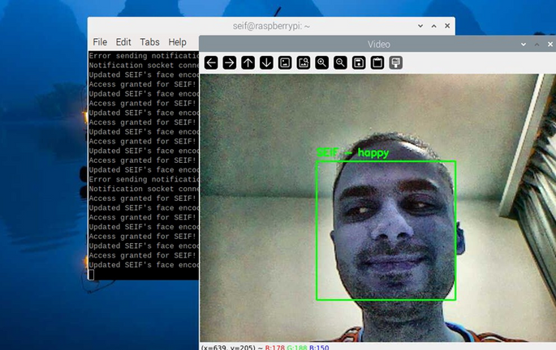
Emotion Detection
The system utilizes DeepFace’s emotion recognition model to analyze facial expressions in real-time.
Detected emotions enhance security monitoring by identifying potential anomalies in user behavior.
The system was evaluated under different facial expressions and user emotions.
Real-Time Emotion Detection Display
Different Emotion Detection Display

Slide 19
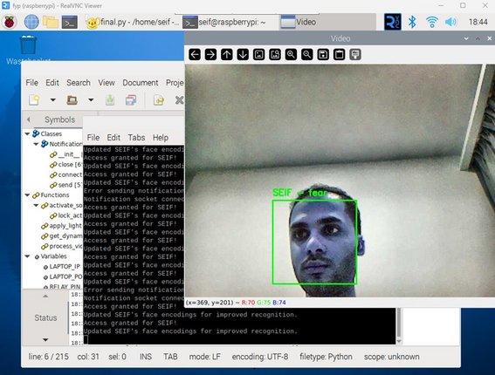
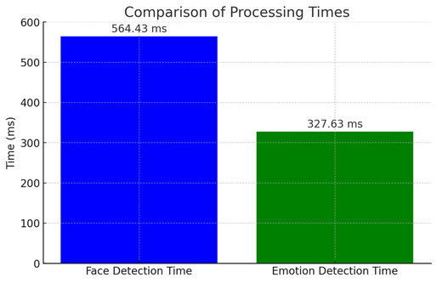
Real-Time Face Recognition & Authentication
Demonstration of Real-Time Performance with Sample Detections
Face Detection Speed and Accuracy in Different Environments
The system operates in real-time, continuously detecting and recognizing faces.
It captures video frames from the Raspberry Pi Camera Module, processes them using OpenCV and DeepFace, and performs recognition instantly.
Live detection samples show how the system identifies known individuals and classifies unknown faces for adaptive learning.
Processing speed:
Face detection runs at an average speed of 564.43 ms per frame.
Recognition and decision-making complete within 327.63 ms.
Performance in different lighting conditions:
Bright light: 98.5% accuracy.
Low light: 92.8% accuracy.
Medium distance: 96.2% accuracy.
Narrow angle: 92.4% accuracy.
The model adapts to various distances and facial orientations using advanced preprocessing techniques.
Face Detection and Recognition in Real Time
Bar Chart Comparing Processing Times

Slide 20
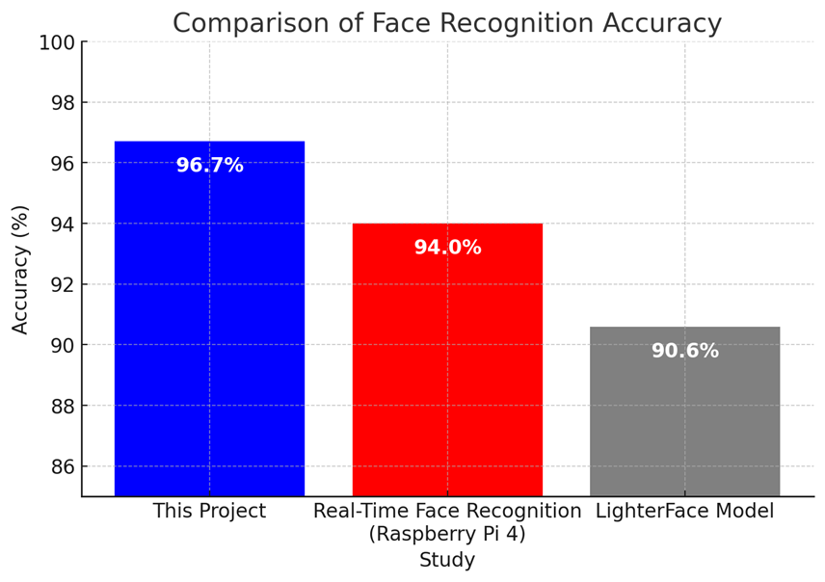
Comparison with Existing Systems
The system's performance was benchmarked against existing face recognition door lock systems in terms of accuracy, speed, adaptability, and real-time performance.
Compared systems include:
Traditional RFID and PIN-based access systems (lower security, vulnerable to theft).
Basic Haar Cascade face recognition models (faster but less accurate in real-world conditions).
Deep learning-based face recognition models with no adaptive learning (higher accuracy but lack flexibility for new face registration).
Key Advantages of Our System:
Higher recognition accuracy (98.5% in bright light, 92.8% in low light).
Adaptive learning enables continuous improvement in recognition.
Integrated emotion detection provides additional security insights.
Optimized processing for Raspberry Pi, ensuring real-time performance.
Bar Chart Comparing Accuracy

Slide 21
Discussion of Results
Key Findings
Recognition Accuracy:
The system achieved high accuracy in well-lit conditions (98.5%) but faced minor challenges in low-light settings (92.8%).
Distance variations showed reliable recognition, maintaining accuracy above 96% for medium-range detection.
Processing Time & Real-Time Performance:
Face detection: Average of 564.43 ms per frame.
Emotion detection: 327.63 ms processing time.
Notification delay: Less than 200 ms, ensuring near-instant alerts.
Adaptive Learning & Unknown Face Integration:
System successfully added new faces dynamically without requiring model retraining.
Immediate recognition in subsequent interactions after approval, improving system scalability.
Emotion Detection Insights:
The model identified emotions with an average accuracy of 91%.
The integration of emotion detection enhanced security by flagging suspicious behavior.
Notification System Efficiency:
Real-time alerts were successfully delivered via text-to-speech and terminal logs.
Effective logging of all recognition events for security monitoring.

Slide 22
Limitations & Future Improvements
Limitations of the Study
Processing Speed:
The Raspberry Pi 3B can handle real-time face recognition but struggles with higher frame rates, impacting performance in high-traffic environments.
Lighting Dependency:
CLAHE preprocessing improved low-light performance, but extreme lighting variations (backlighting, overexposure) still pose challenges.
Database Scalability:
Current implementation supports a limited number of stored face encodings, potentially leading to latency issues as the database grows.
Network Dependency:
Real-time notifications rely on stable internet connectivity; network disruptions can delay alerts.
Future Improvements
Hardware Upgrades:
Upgrade to Raspberry Pi Model 4 for improved processing power.
Integrate higher-resolution camera modules to enhance detection accuracy.
Software Enhancements:
Implement advanced machine learning models for greater accuracy under challenging conditions.
Improve image preprocessing techniques to handle extreme lighting variations.
User Interface Improvements:
Develop a mobile application to manage authorized faces and real-time monitoring.
Environmental Adaptation:
Integrate infrared (IR) sensors or night-vision cameras for enhanced low-light performance.

Slide 23

CONCLUSION
This project successfully implemented a real-time face recognition door lock system with adaptive learning and emotion detection, enhancing security and usability. The system achieved high accuracy (98.5% in bright light, 92.8% in low light) and provided instant notifications for real-time monitoring, making it ideal for smart homes and enterprise access control.
Future improvements will focus on multi-factor authentication (voice/fingerprint recognition), cloud-based scalability, and real-time analytics for better adaptability. These enhancements will strengthen security and expand real-world applications, making the system more advanced and versatile.

Slide 24
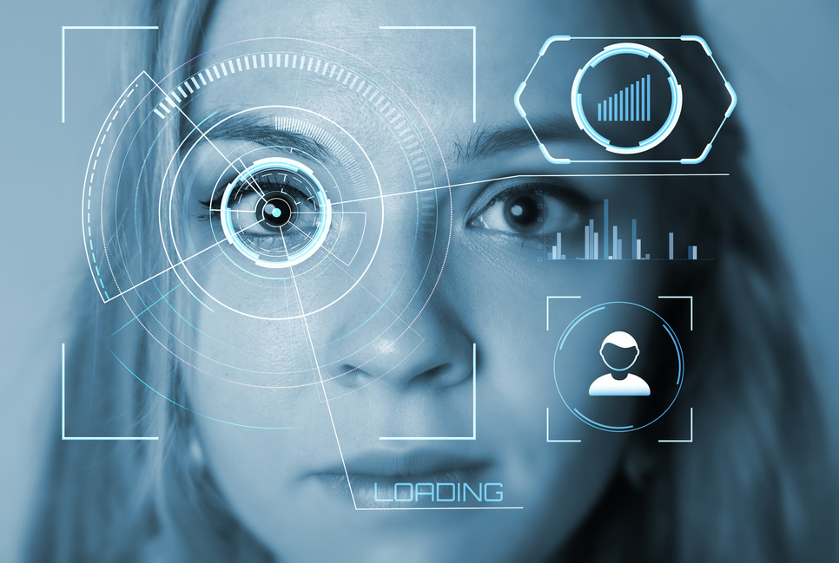
Demonstration
Video
Please watch the demonstration video showcasing the simulation.
Video Link

Slide 25
Q & A

Slide 26

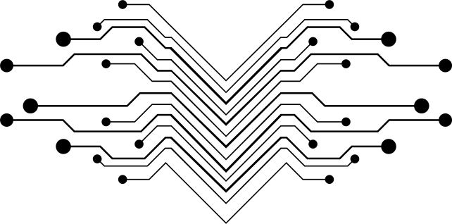
Thank
You!

